Slide 1
Introduction to Probability and Statistics
Twelfth Edition
Robert J. Beaver • Barbara M. Beaver • William Mendenhall
Presentation designed and written by:
Barbara M. Beaver

Slide 2
Introduction to Probability and Statistics
Twelfth Edition
Chapter 6
The Normal Probability Distribution
Some graphic screen captures from Seeing Statistics ®
Some images © 2001-(current year) www.arttoday.com

Slide 3
Continuous Random Variables
Continuous random variables can assume the infinitely many values corresponding to points on a line interval.
Examples:
  Heights, weights
  length of life of a particular product
  experimental laboratory error

Slide 4
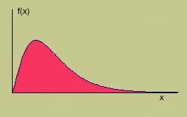
Continuous Random Variables
A smooth curve describes the probability distribution of a continuous random variable.
The depth or density of the probability, which varies with x, may be described by a mathematical formula f (x ), called the probability distribution or probability density function for the random variable x.

Slide 5
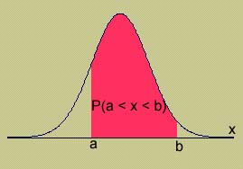
Properties of Continuous
Probability Distributions
The area under the curve is equal to 1.
P(a ≤ x ≤ b) = area under the curve between a and b.
There is no probability attached to any single value of x. That is, P(x = a) = 0.

Slide 6
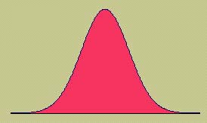
Continuous Probability Distributions
There are many different types of continuous random variables
We try to pick a model that
  Fits the data well
  Allows us to make the best possible inferences using the data.
One important continuous random variable is the normal random variable.

Slide 7
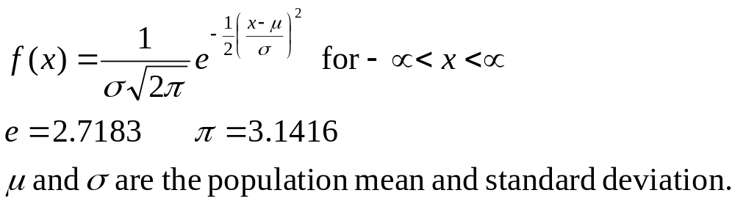
The Normal Distribution
The formula that generates the normal probability distribution is:
The shape and location of the normal curve changes as the mean and standard deviation change.
MY
APPLET

Slide 8
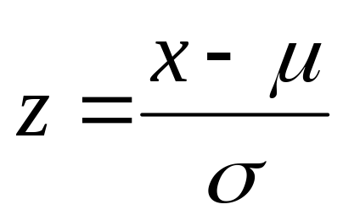
The Standard Normal Distribution
To find P(a < x < b), we need to find the area under the appropriate normal curve.
To simplify the tabulation of these areas, we standardize each value of x by expressing it as a z-score, the number of standard deviations σ it lies from the mean μ.

Slide 9
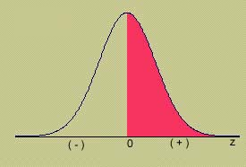
The Standard Normal (z) Distribution
Mean = 0; Standard deviation = 1
When x = μ, z = 0
Symmetric about z = 0
Values of z to the left of center are negative
Values of z to the right of center are positive
Total area under the curve is 1.

Slide 10
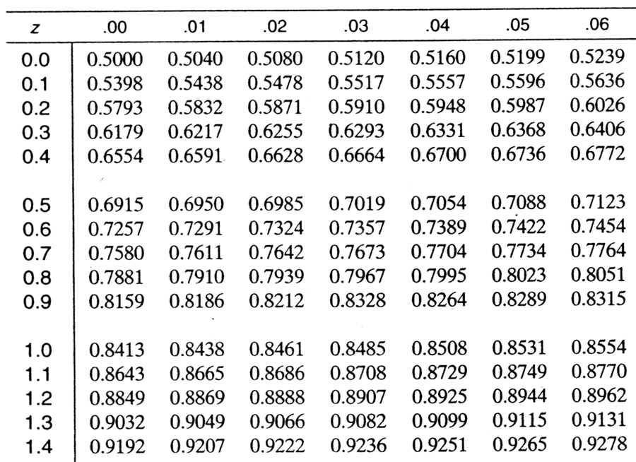
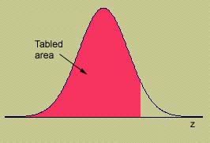
Using Table 3
The four digit probability in a particular row and column of Table 3 gives the area under the z curve to the left that particular value of z.
Area for z = 1.36

Slide 11
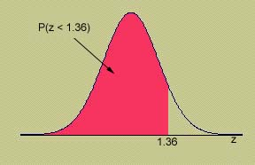
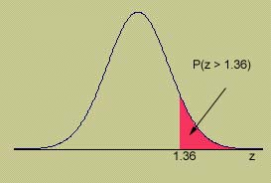
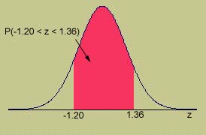
Example
MY
APPLET
Use Table 3 to calculate these probabilities:
P(z ≤1.36) = .9131
P(z >1.36)
= 1 - .9131 = .0869
P(-1.20 ≤ z ≤ 1.36) = .9131 - .1151 = .7980

Slide 12
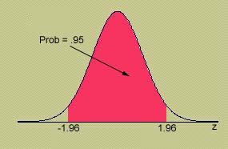
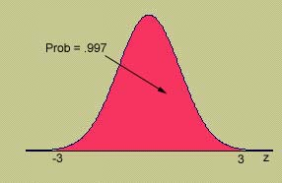
Using Table 3
MY
APPLET
To find an area to the left of a z-value, find the area directly from the table.
To find an area to the right of a z-value, find the area in Table 3 and subtract from 1.
To find the area between two values of z, find the two areas in Table 3, and subtract one from the other.
Remember the Empirical Rule: Approximately 99.7% of the measurements lie within 3 standard deviations of the mean.
Remember the Empirical Rule: Approximately 95% of the measurements lie within 2 standard deviations of the mean.
P(-1.96 ≤ z ≤ 1.96) = .9750 - .0250 = .9500
P(-3 ≤ z ≤ 3)
= .9987 - .0013=.9974

Slide 13
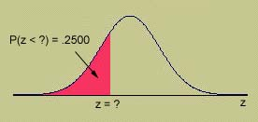
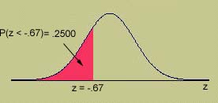
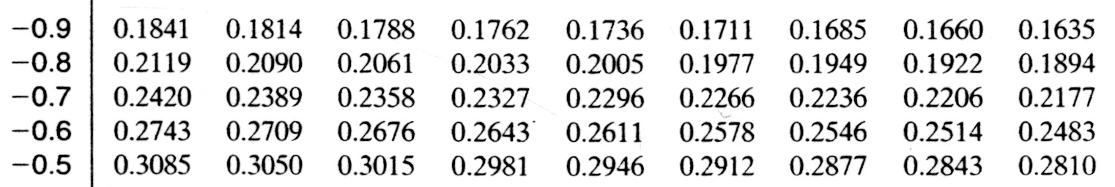
Working Backwards
MY
APPLET
Find the value of z that has area .25 to its left.
Look for the four digit area closest to .2500 in Table 3.
What row and column does this value correspond to?
3. z = -.67
4. What percentile does this value represent?
25th percentile,
or 1st quartile (Q₁)

Slide 14
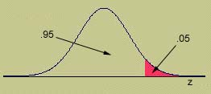
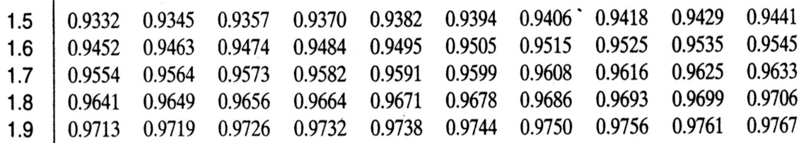
Working Backwards
MY
APPLET
Find the value of z that has area .05 to its right.
The area to its left will be 1 - .05 = .95
Look for the four digit area closest to .9500 in Table 3.
Since the value .9500 is halfway between .9495 and .9505, we choose z halfway between 1.64 and 1.65.
z = 1.645

Slide 15
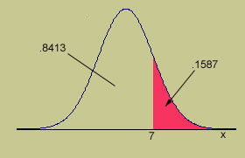
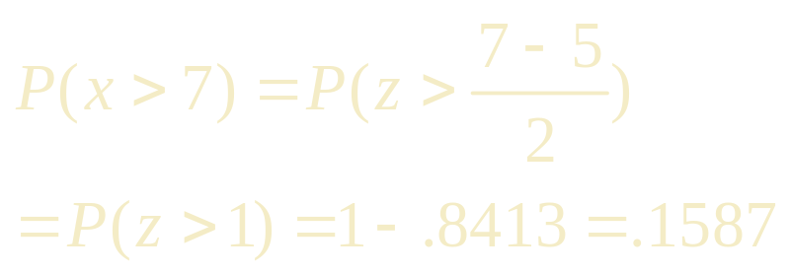
Finding Probabilities for the General Normal Random Variable
To find an area for a normal random variable x with mean μ and standard deviation σ, standardize or rescale the interval in terms of z.
Find the appropriate area using Table 3.
Example: x has a normal distribution with μ = 5 and σ = 2. Find P(x > 7).
1 z

Slide 16
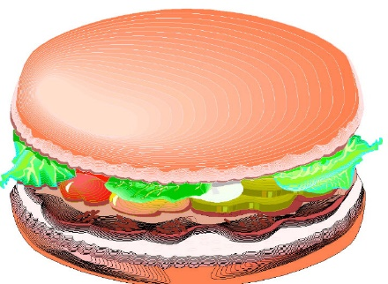
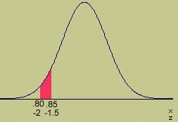
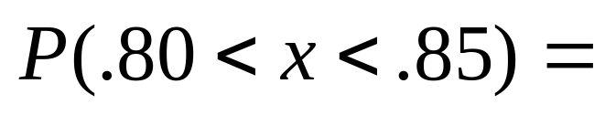
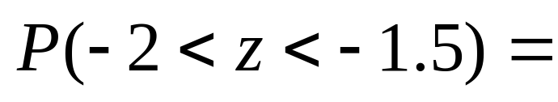
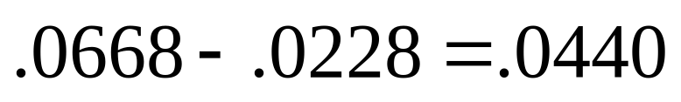
Example
MY
APPLET
The weights of packages of ground beef are normally distributed with mean 1 pound and standard deviation .10. What is the probability that a randomly selected package weighs between 0.80 and 0.85 pounds?

Slide 17
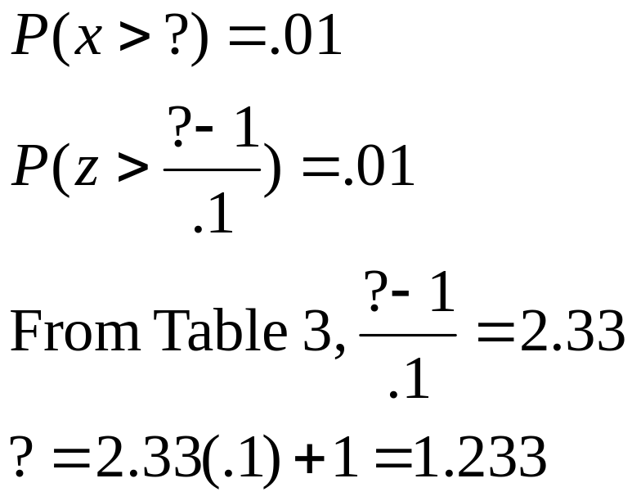
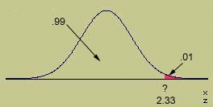
Example
MY
APPLET
What is the weight of a package such that only 1% of all packages exceed this weight?

Slide 18
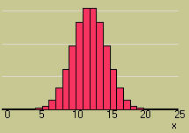
The Normal Approximation to the Binomial
We can calculate binomial probabilities using
  The binomial formula
  The cumulative binomial tables
  Java applets
When n is large, and p is not too close to zero or one, areas under the normal curve with mean np and variance npq can be used to approximate binomial probabilities.

Slide 19
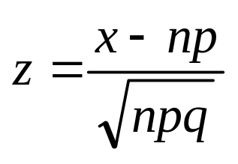
Approximating the Binomial
Make sure to include the entire rectangle for the values of x in the interval of interest. This is called the continuity correction.
Standardize the values of x using
Make sure that np and nq are both greater than 5 to avoid inaccurate approximations!

Slide 20
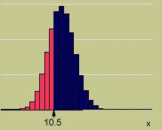
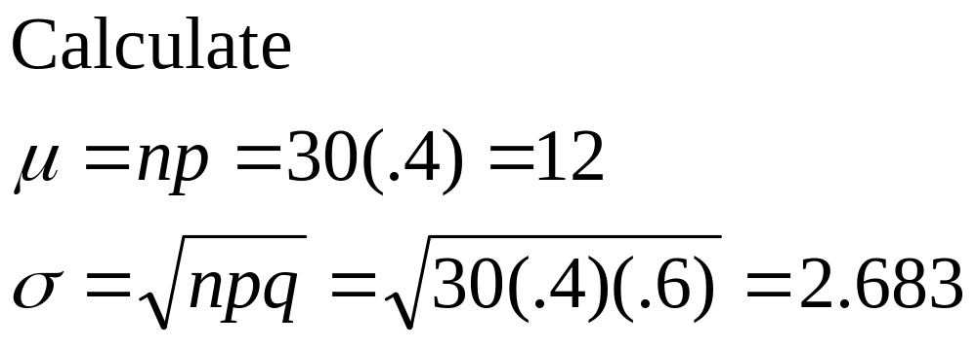
Example
Suppose x is a binomial random variable with n = 30 and p = .4. Using the normal approximation to find P(x ≤ 10).
n = 30 p = .4 q = .6
np = 12 nq = 18
The normal approximation is ok!

Slide 21
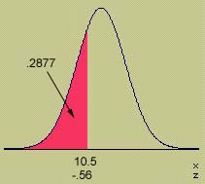
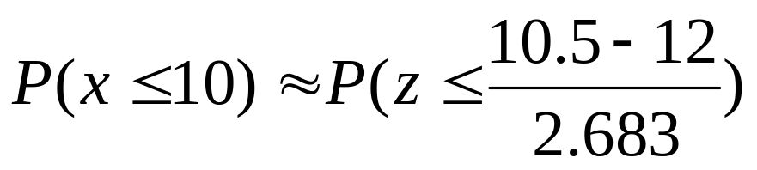
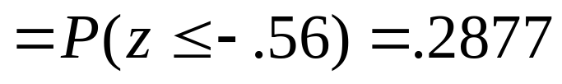
Example
MY
APPLET

Slide 22

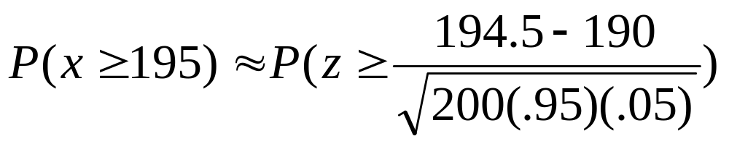
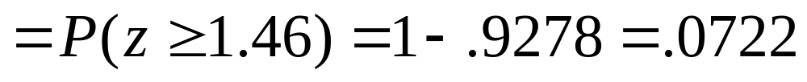
Example
A production line produces AA batteries with a reliability rate of 95%. A sample of n = 200 batteries is selected. Find the probability that at least 195 of the batteries work.
The normal approximation is ok!
Success = working battery n = 200
p = .95 np = 190 nq = 10

Slide 23
Key Concepts
I. Continuous Probability Distributions
1. Continuous random variables
2. Probability distributions or probability density functions
a. Curves are smooth.
b. The area under the curve between a and b represents
the probability that x falls between a and b.
c. P (x = a) = 0 for continuous random variables.
II. The Normal Probability Distribution
1. Symmetric about its mean μ .
2. Shape determined by its standard deviation σ .

Slide 24

Key Concepts
III. The Standard Normal Distribution
1. The normal random variable z has mean 0 and standard
deviation 1.
2. Any normal random variable x can be transformed to a
standard normal random variable using
3. Convert necessary values of x to z.
4. Use Table 3 in Appendix I to compute standard normal
probabilities.
5. Several important z-values have tail areas as follows:
Tail Area: .005 .01 .025 .05 .10
z-Value: 2.58 2.33 1.96 1.645 1.28

